Slide 1
Motivation for looking at AERONET inversion products
The simple linear association between satellite AOD and PM is not generally that strong (R²~0.01-0.3)
Rely on meteorology, land use, chemical transport models, spatial and temporal variables in complex, adjusted models
AOD not necessarily the “best” or most important variable in predicting PM mass or PM speciation
Key Questions:
Can we calibrate AOD-PM at AERONET sites and reliably apply these models to satellite AOD?
What properties can we retrieve that associate best with PM and PM speciation?

Slide 2
Takeaways from AERONET sunphotometer
Co-located AERONET and PM_{2.5} sites from the DRAGON campaign in California Central Valley
Linear regression (R²=0.35) is significantly improved with spatial and temporal terms.
The longer time series at Fresno has the largest contribution to improved R² and RMSE.
The AERONET-calibrated models perform comparably when applied to convert satellite (MISR) AOD.
Sorek-Hamer, M., Franklin, M., Chau, K., Garay, M., & Kalashnikova, O. (2020). Spatiotemporal Characteristics of the Association between AOD and PM over the California Central Valley. Remote Sensing, 12(4), 685.

Slide 3
Takeaways from MISR
PM_{2.5}
Using MISR AOD types and mixtures we find that total AOD is not necessarily the most important variable:
For mass, sulfate, nitrate AOD types (small, medium, non-spherical)
For EC, AOD is 8th most important
For dust, the mixtures (combination of MISR types) are most important
Sulfate
Nitrate
EC
Dust
Chau, K., Franklin, M., & Gauderman, W. J. (2020). Satellite-Derived PM2.5 Composition and Its Differential Effect on Children’s Lung Function. Remote Sensing, 12(1028).

Slide 4
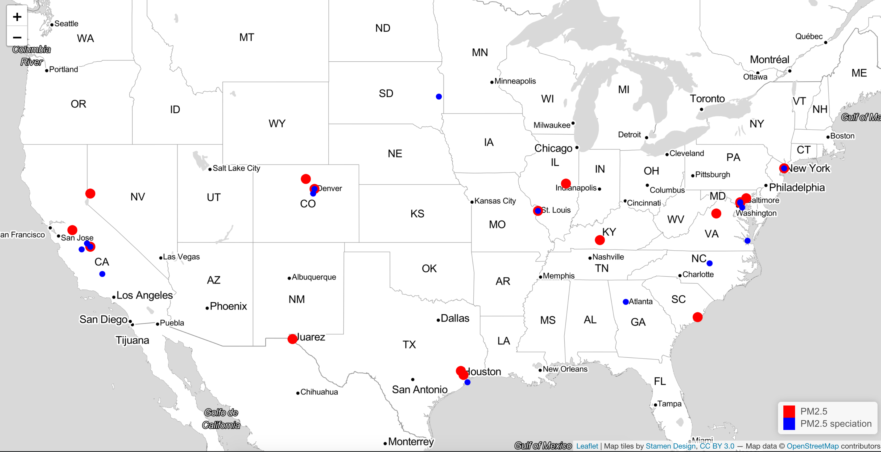
AERONET Inversion Products
AERONET sites have a retrieved “inversion” product providing optical components (40+).
The retrieval uses Optimal Estimation (Dubovik et al), MAIA is implementing similar retrieval.
These sites are also co-located EPA AQS and chemical speciation monitors (CSN) where we have ions, metals, carbons

Slide 5
Co-located AERONET - PM Summary
We see expected regional trends
Mass concentrations higher in west
Nitrate concentrations higher in west
Sulfate concentrations higher in east
EC concentrations higher in east
OC concentrations higher in west
Region | N mass | PM_{2.5} mean(sd) | N spec | PM_{2.5} Sulfate mean(sd) | PM_{2.5} Nitrate mean(sd) | PM_{2.5} EC mean(sd) | PM_{2.5} OC mean(sd)
West | 3248 | 14.1 (12.6) | 554 | 1.1 (0.46) | 3.4 (5.5) | 0.74 (0.69) | 3.5 (3.4)
Central | 610 | 7.1 (3.4) | 40 | 0.51 (0.23) | 0.44 (0.55) | 0.63 (0.29) | 1.7 (0.68)
East | 715 | 8.5 (4.3) | 357 | 3.6 (3.4) | 1.7 (3.5) | 1.35 (0.81) | 2.3 (1.30)
All | 7028 | 12.2 (10.3) | 2050 | 1.9 (2.3) | 1.7 (3.5) | 0.59 (0.55) | 2.4 (2.6)

Slide 6
Correlation Regression Tree of AERONET Products
Correlations in meaningful clusters.
For example:
Effective radii and asymmetry factors show high positive correlations within size grouping (total, coarse, fine)
AOD at different wavelengths are also highly positively correlated with each other
Angstrom exponents (AE) at all wavelengths have correlations >0.9 (as such we selected to use only the 440-675 nm AE in linear model selection)
AOD ( 340nm-1020nm), Column Water Vapor, Angstrom Exponent, Asymmetry factor coarse/fine (440nm-1020nm), AOD Extinction coarse/fine (440nm-1020nm), Effective Radius
We used all possible subsets regression and model selection as well as XGBoost (gradient boosting)

Slide 7
AERONET Inversion products – PM_{2.5} Results
The simple linear regression between AOD 550 and PM_{2.5} has an overall R² = 0.27
The best linear model with the inversion products R² =0.70 and RMSE = 5.03 ug/m³
The overall XGBoost model R²=0.76, RMSE = 5.07 ug/m³
There are regional differences (Table)
There is consistency in the inversion products selected for PM_{2.5} The most important variables include:
Effective Radius (Fine), Angstrom Exponent 440-675, and AOD Extinction (fine, multiple wavelengths). No AOD!
Region | N mass | R² | RMSE ug/m³ | MAE ug/m³
West | 3322 | 0.89 | 4.43 | 3.07
Central | 610 | 0.74 | 1.70 | 1.39
East | 442 | 0.81 | 2.23 | 1.65
All | 7028 | 0.76 | 5.11 | 3.49

Slide 8
west
central
east
St Louis
Overall important variables
AOD extinction fine and total at multiple wavelengths
Extinction Angstrom Exponent
all

Slide 9
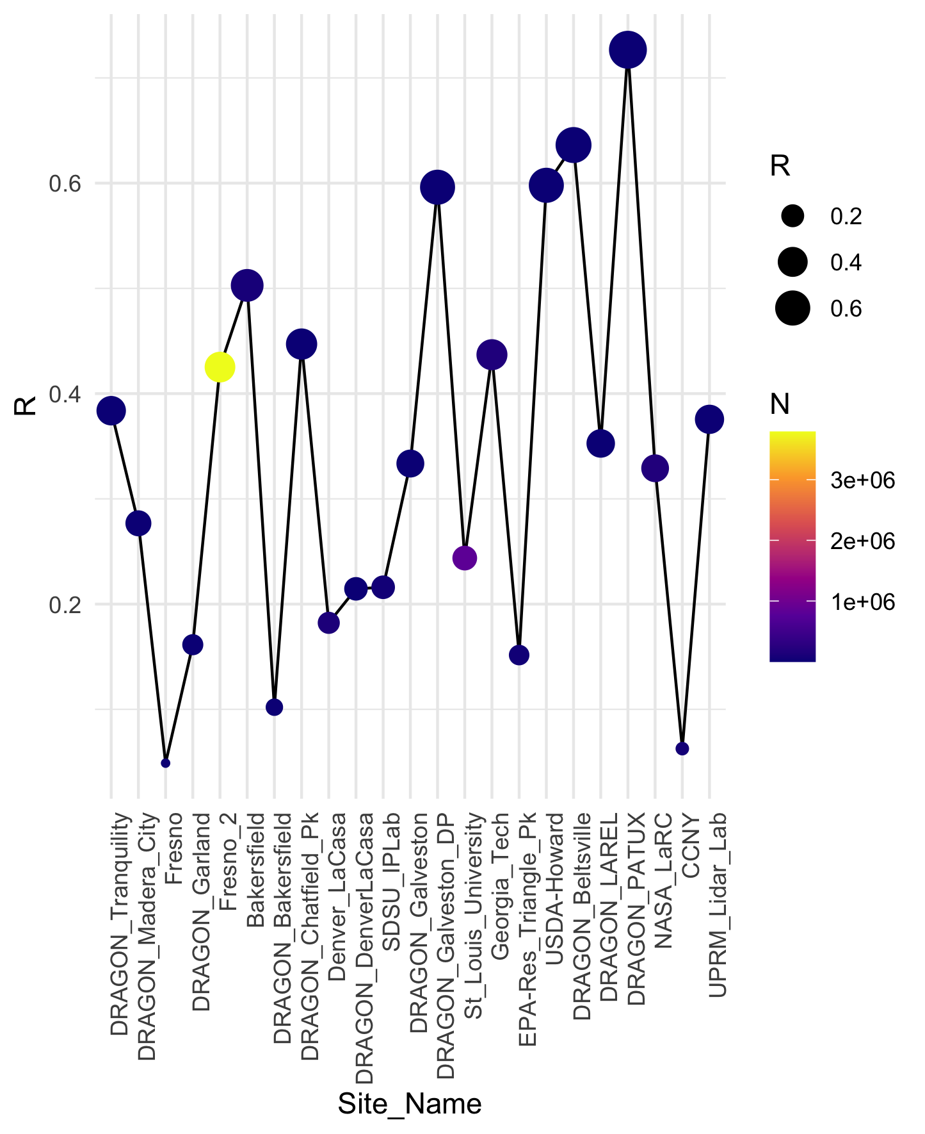

Slide 10
AERONET Inversion products – PM_{2.5} Nitrate Results
The simple linear regression between AOD 550 and PM_{2.5} has an overall R² = 0.33
The best linear model with the inversion products R² =0.71
The overall XGBoost model R²=0.67, RMSE = 1.51 ug/m³
There are large regional differences
There is consistency in the inversion products selected for nitrate The most important variables include:
Effective Radius (Fine), Asymmetry Factors, AOD 440 nm, Angstrom exponent, Volume Median Radius.
Region | N mass | R² | RMSE ug/m³ | MAE ug/m³
West | 3248 | 0.94 | 1.43 | 0.79
Central | 610 | 0.31 | 0.53 | 0.41
East | 715 | 0.40 | 0.94 | 0.59
All | 7028 | 0.67 | 1.51 | 1.02

Slide 11
AERONET Inversion products – PM_{2.5} Sulfate Results
The simple linear regression between AOD 550 and PM_{2.5} has an overall R² = 0.27
The best linear model with the inversion products R² =0.48
The overall XGBoost model R²=0.62, RMSE = 1.43 ug/m³
There are large regional differences
There is consistency in the inversion products selected for nitrate The most important variables include:
Volume Concentration (Fine), Asymmetry Factors, Volume Median Radius, AOD 440 nm.
Region | N mass | R² | RMSE ug/m³ | MAE ug/m³
West | 3248 | 0.81 | 0.22 | 0.16
Central | 610 | 0.35 | 0.69 | 0.48
East | 715 | 0.63 | 2.07 | 1.31
All | 7028 | 0.62 | 1.43 | 0.81

Slide 12
AERONET Inversion products – PM_{2.5} EC Results
The simple linear regression between AOD 550 and PM_{2.5} has an overall R² = 0.03
The best linear model with the inversion products R² =0.32
The overall XGBoost model R²=0.41, RMSE = 0.42 ug/m³
There are regional differences (Table)
There is consistency in the inversion products selected for EC The most important variables include:
Volume Median Radius total and fine, and their standard deviations, asymmetry factor coarse and total, AOD 1020 nm.
Region | N mass | R² | RMSE ug/m³ | MAE ug/m³
West | 3248 | 0.79 | 0.32 | 0.22
Central | 610 | 0.49 | 0.28 | 0.23
East | 715 | 0.31 | 0.77 | 0.57
All | 7028 | 0.41 | 0.42 | 0.29

Slide 13
AERONET Inversion products – PM_{2.5} OC Results
The simple linear regression between AOD 550 and PM_{2.5} has an overall R² = 0.09
The best linear model with the inversion products R² =0.35
The overall XGBoost model R²=0.38, RMSE = 0.44 ug/m³
There are regional differences (Table)
There is consistency in the inversion products selected for OC The most important variables include:
Asymmetry factors (total), AOD extinction fine and coarse, Angstrom Exponent, AOD 440 nm.
Region | N mass | R² | RMSE ug/m³ | MAE ug/m³
West | 3248 | 0.79 | 1.37 | 0.94
Central | 610 | 0.54 | 0.67 | 0.51
East | 715 | 0.51 | 1.00 | 0.82
All | 7028 | 0.63 | 1.47 | 1.00

Slide 14
AERONET Inversion products – PM_{2.5} Dust Results
The simple linear regression between AOD 550 and PM_{2.5} has an overall R² = 0.003
The best linear model with the inversion products R² =0.56
The overall XGBoost model R²=0.86, RMSE = 0.55 ug/m³
There are regional differences
There is consistency in the inversion products selected for OC The most important variables include:
Volume concentrations coarse and total, asymmetry factors coarse, effective radius coarse.
Dust = 2.2Al+2.49Si+1.63Ca+1.94Ti+2.42Fe
Region | N mass | R² | RMSE ug/m³ | MAE ug/m³
West | 3248 | 0.85 | 0.54 | 0.26
Central | 610 | 0.60 | 0.59 | 0.49
East | 715 | 0.89 | 0.16 | 0.11
All | 7028 | 0.86 | 0.55 | 0.31

Slide 15
Summary and Conclusions
When predicting PM and PM speciation, AOD alone is not sufficient
Evidence that other optical properties can significantly improve the associations
Specific properties relate to PM mass or PM speciation
All subsets linear regression and XGboost yield similar variables selected for best model
Machine learning improves R² significantly
Region and available time series matter: longer time series produces more data and stable models.
More targeted variable selection and machine learning methods will help inform best products for predicting PM and PM species from retrieval.

